Slide 1

BS1220: Introduction to Software Design and Development
Week 8 Hybrid Session 1

Slide 2
8.5: This Week
Feasibility Analysis
Competitor Analysis
Group Debate: Feasibility and Competitor Analysis is a Waste of Time and Resources

Slide 3
Recap
What is feasibility analysis?
“A feasibility study is an analysis that takes all of a project's relevant factors into account—including economic, technical, legal, and scheduling considerations—to ascertain the likelihood of completing the project successfully” (Investopedia, 2020)
What is competitor analysis?
“An assessment of the position of potential competitors to identify opportunities and risks of a strategy” (Simplicable, 2017)

Slide 4
8.6: Conducting a Feasibility Analysis
T
Technological
E
Economic
L
Legal
O
Organisational
S
Scheduling

Slide 5


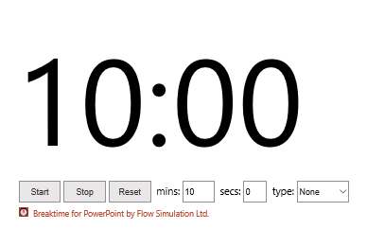
Activity 1
Complete a feasibility analysis for the case study you developed in the post-session activities last week

Slide 6

8.7: Porter’s 5 Forces
Help you to understand the competitiveness of your business environment
What is the potential profitability of your strategy?
5 Forces:
Competitive Rivalry
Supplier Power
Buyer Power
Threat of Substitution
Threat of New Entry
Can be used for monitoring strategy so you can adapt to a changing environment

Slide 7
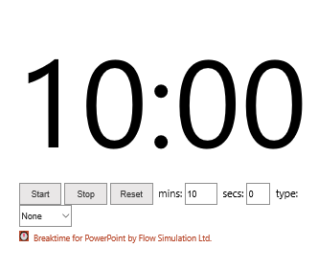
Activity 2
Complete your assigned poster on Porter’s Five Forces
Group C must include:
What Porter’s Five Forces tells us
Background to the model
A diagram showing how the forces interact
How it can be used to help shape projects
Groups A, B, D, E, and F must include:
What the force is
Why it should be considered
The impact it has on Software Engineering Project
An example of how the force has impacted another organisation

Slide 8

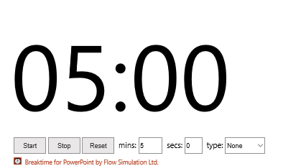
Poster Viewing
Take the next 5 minutes to look through the posters for the other groups

